Slide 1
Perfecto Extensions to Appium & Selenium

Slide 2
Perfecto Extensions to Appium
1
Introducing Perfecto extensions
2
Inserting Perfecto commands into tests

Slide 3
Perfecto Extensions

Slide 4
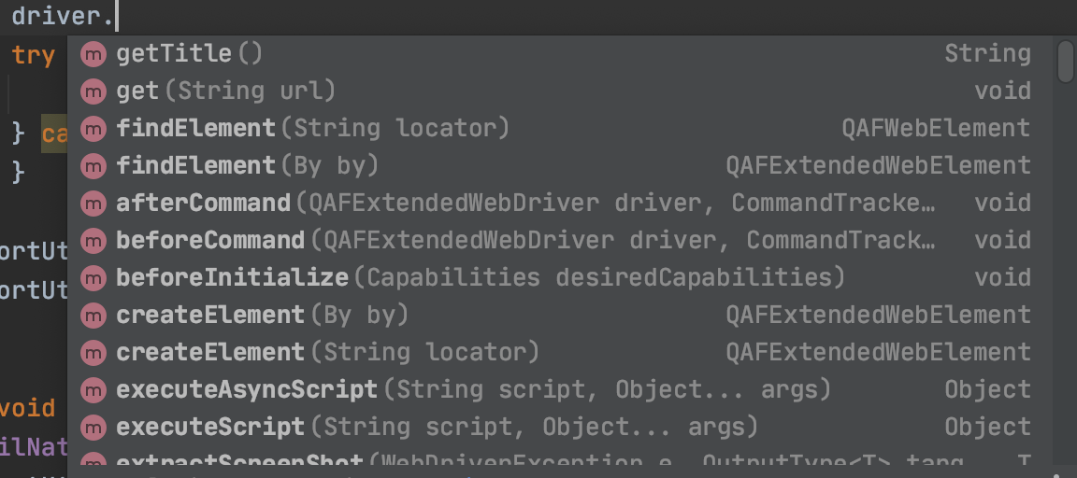
Perfecto Extensions
Perfecto offers complete support of all
Appium & Selenium commands.
These commands are built into the driver created at runtime. In the code it looks like this:
loginlNativeButton.click();
QAFExtendedWebElement ele = new QAFExtendedWebElement(By.xpath("//*[@label='OK']"));
All these commands can be accessed from the driver object

Slide 5
Inserting Perfecto commands into tests

Slide 6
Proprietary Commands
Perfecto also provides a wide range of propriatey commands. These commands can be used through the executeScript method in Selenium.
We will look at these commands today and see how to use them in our code
Commands list - https://help.perfecto.io/perfecto-help/content/perfecto/automation-testing/execute_proprietary_functions.htm
Let’s go over the list – keep your eye open for commands that could be relevant to your requirements.

Slide 7
Using Perfecto commands in our tests
Inside Cucumber feature
Many commands are already implemented
View the auto-complete inside the feature file to view
Inside custom Java step
We can add any command we need into our Java code.
The flow is similar to all commands
Find the needed command
Copy the Java sample
Edit the parameters as needed
Execute
Commands all use the hashmap to collate the params and the executeScript to run
Map<String, Object> params = new HashMap<>(); params.put("content", "Email"); params.put("timeout", "15"); driver.executeScript("mobile:text:find", params);

Slide 8
THANK YOU

